Slide 1
COMP8620
Lecture 5-6
Neighbourhood Methods, and Local Search
(with special emphasis on TSP)

Slide 2
Assignment
http://users.rsise.anu.edu.au/~pjk/teaching
“Project 1”

Slide 3
Neighbourhood
For each solution S ∈ S, N(S) ⊆ S
is a neighbourhood
In some sense each T ∈ N(S) is in some sense “close” to S
Defined in terms of some operation
Very like the “action” in search

Slide 4
Neighbourhood
Exchange neighbourhood:
Exchange k things in a sequence or partition
Examples:
Knapsack problem: exchange k₁ things inside the bag with k₂ not in.
(for k_{i,} k₂ = {0, 1, 2, 3})
Matching problem: exchange one marriage for another

Slide 5
2-opt Exchange

Slide 6
2-opt Exchange

Slide 7
2-opt Exchange

Slide 8
2-opt Exchange

Slide 9
2-opt Exchange

Slide 10
2-opt Exchange

Slide 11
3-opt exchange
Select three arcs
Replace with three others
2 orientations possible

Slide 12
3-opt exchange

Slide 13
3-opt exchange

Slide 14
3-opt exchange

Slide 15
3-opt exchange

Slide 16
3-opt exchange

Slide 17
3-opt exchange

Slide 18
3-opt exchange

Slide 19
3-opt exchange

Slide 20
3-opt exchange

Slide 21
3-opt exchange

Slide 22
3-opt exchange

Slide 23
Neighbourhood
Strongly connected:
Any solution can be reached from any other
(e.g. 2-opt)
Weakly optimally connected
The optimum can be reached from any starting solution

Slide 24
Neighbourhood
Hard constraints create solution impenetrable mountain ranges
Soft constraints allow passes through the mountains
E.g. Map Colouring (k-colouring)
  Colour a map (graph) so that no two adjacent countries (nodes) are the same colour
  Use at most k colours
  Minimize number of colours

Slide 25
Map Colouring
✗
✓
?
Starting sol
Two optimal solutions
Define neighbourhood as:
Change the colour of at most one vertex
Make k-colour constraint soft…

Slide 26
Iterative Improvement
Find initial (incumbent) solution S
Find T ∈ N(S) which minimises objective
If z(T) ≥ z(S)
    Stop
Else
  S = T
  Goto 2

Slide 27
Iterative Improvement
Best First (a.k.a Greedy Hill-climbing, Discrete Gradient Ascent)
  Requires entire neighbourhood to be evaluated
  Often uses randomness to split ties
First Found
  Randomise neighbourhood exploration
  Implement first improving change

Slide 28
Local Minimum
Iterative improvement will stop at a local minimum
Local minimum is not necessarily a global minimum
How do you escape a local minimum?

Slide 29
Restart
Find initial solution using (random) procedure
Perform Iterative Improvement
Repeat, saving best
Remarkably effective
Used in conjunction with many other meta-heuristics

Slide 30
Results from SAT

Slide 31
Variable Depth Search
Make a series of moves
Not all moves are cost-decreasing
Ensure that a move does not reverse previous move
Very successful VDS: Lin-Kernighan algorithm for TSP (1973)
(Originally proposed for Graph Partitioning Problem (1970))

Slide 32
Lin-Kernighan (1973) – δ-path
u
v
u
v
w
u
v
w
v’
u
v
w’
w
v’

Slide 33
Lin-Kernighan (1973)
Essentially a series of 2-opt style moves
Find best δ-path
Partially implement the path
Repeat until no more paths can be constructed
If arc has been added (deleted) it cannot be deleted (added)
Implement best if cost is less than original

Slide 34
Dynasearch
Requires all changes to be independent
Requires objective change to be cummulative
e.g. A set of 2-opt changes were no two swaps touched the same section of tour
Finds best combination of exchanges
  Exponential in worst case

Slide 35
Variable Neighbourhood Search
Large Neighbourhoods are expensive
Small neighbourhoods are less effective
Only search larger neighbourhood when smaller is exhausted

Slide 36
Variable Neighbourhood Search
m Neighbourhoods N_{i}
|N₁| < |N₂| < |N₃| < … < |N_{m}|
Find initial sol S ; best = z (S)
k = 1;
Search N_{k}(S) to find best sol T
If z(T) < z(S)
S = T
k = 1
else
k = k+1

Slide 37
Large Neighbourhood Search
Partial restart heuristic
Create initial solution
Remove a part of the solution
Complete the solution as per step 1
Repeat, saving best

Slide 38
LNS – Construct

Slide 39
LNS – Construct

Slide 40
LNS – Construct

Slide 41
LNS – Construct

Slide 42
LNS – Construct

Slide 43
LNS – Construct

Slide 44
LNS – Construct

Slide 45
LNS – Construct

Slide 46
LNS – Construct

Slide 47
LNS – Construct

Slide 48
LNS – Construct

Slide 49
LNS – Destroy

Slide 50
LNS – Destroy

Slide 51
LNS – Destroy

Slide 52
LNS – Destroy

Slide 53
LNS – Construct

Slide 54
LNS – Construct

Slide 55
LNS
The magic is choosing which part of the solution to destroy
Different problems (and different instances) need different heuristic

Slide 56
Speeding Up 2/3-opt
For each node, store k nearest neighbours
Only link nodes if they appear on list
k = 20 does not hurt performance much
k = 40 0.2% better
k = 80 was worse
FD-trees to help initialise

Slide 57
Advanced Stochastic Local Search
Simulated Annealing
Tabu Search
Genetic algorithms
Ant Colony optimization

Slide 58
Simulated Annealing
Kirkpatrick, Gelatt & Vecchi [1983]
Always accept improvement in obj
Sometimes accept increase in obj
P(accept increase of Δ) = e ^{Δ/T}
T is temperature of system
Update T according to “cooling schedule”
(T = 0) == Greedy Iterative Improvement

Slide 59
Simulated Annealing
Nice theoretical result:
As number of iters → ∞, probability of finding the optimal solution → 1
Experimental confirmation: On many problem, long runs yield good results
Weak optimal connection required

Slide 60
Simulated Annealing
Generate initial S
Generate random T ∈ N(S)
Δ = z (T) – z (S)
if Δ < 0
S = T ; goto 2
if rand() < e ^{Δ/T}
S = T ; goto 2

Slide 61
Simulated Annealing
Initial T
Set equal to max [acceptable] Δ
Updating T
Geometric update: T_{k+1} = α T_{k}
α usually in [0.9, 0.999]
Don’t want too many changes at one temperature (too hot):
If (numChangesThisT > maxChangesThisT)
  updateT()

Slide 62
Simulated Annealing
Updating T
Many other update schemes
Sophisticated ones look at mean, std-dev of Δ
Re-boil (== Restart)
Re-initialise T
0-cost changes
Handle randomly
Adaptive parameters
If you keep falling into the same local minimum, maxChangesThisT *= 2, or
initialT *= 2

Slide 63
Tabu Search
Glover [1986]
Some similarities with VDS
Allow cost-increasing moves
Selects best move in neighbourhood
Ensure that solutions don’t cycle by making return to previous solution “tabu”
Effectively a modified neighbourhood
Maintains more memory than just best sol

Slide 64
Tabu Search
Theoretical result (also applies to SA):
As k → ∞ P(find yourself at an optimal sol) gets larger relative to other solutions

Slide 65
Tabu Search
Basic Tabu Search:
Generate initial solution S, S* = S
Find best T ∈ N(S)
If z(T) ≥ z(S)
Add T to tabu list
S = T
if z(S) < z(S*) then S* = S
if stopping condition not met, goto 2

Slide 66
Tabu Search
Tabu List:
List of solutions cannot be revisited
Tabu Tenure
The length of time a solution remains tabu
= length of tabu list
Tabu tenure t ensures no cycle of length t

Slide 67
Tabu Search
Difficult/expensive to store whole solution
Instead, store the “move” (delta between S and T)
Make inverse move tabu
  e.g. 2-opt adds 2 new arcs to solution
  Make deletion of both(?) tabu
But
Cycle of length t now possible
Some non-repeated states tabu

Slide 68
Tabu Search
Tabu List:
List of moves that cannot be undone
Tabu Tenure
The length of time a move remains tabu
Stopping criteria
No improvement for <param> iterations
Others…

Slide 69
Tabu Search
Diversification
  Make sure whole solution space is sampled
  Don’t get trapped in small area
Intensification
  Search attractive areas well
Aspiration Criteria
  Ignore Tabu restrictions if very attractive (and can’t cycle)
  e.g.: z(T) < best

Slide 70
Tabu Search
Diversification
  Penalise solutions near observed local minima
  Penalise solution features that appear often
  Penalties can “fill the hole” near a local min
Intensification
  Reward solutions near observed local minima
  Reward solution features that appear often
Use z'(S) = z(S) + penalties

Slide 71
Tabu Search – TSP
TSP Diversification
  Penalise (pred,succ) pairs seen in local minima
TSP Intensification
  Reward (pred,succ) pairs seen in local minima
z'(S) = z(S) + Σ_{ij} w_{ij}count(i,j)
  count(i,j): how many times have we seen (i,j)
  w_{ij}: weight depending on diversify/intensify cycle

Slide 72
Adaptive Tabu Search
If t (tenure) to small, we will return to the same local min
Adaptively modify t
  If we see the same local min, increase t
  When we see evidence that local min escaped (e.g. improved sol), lower t
… my current favourite

Slide 73
Tabu Search
Generate initial solution S ; S* = S
Generate V* ⊆ N(S)
– Not tabu, or meets aspiration criterea
Find T ∈V* which minimises z'
S = T
if z(S) < z(S*) then S* = S
Update tabu list, aspiration criterea, t
if stopping condition not met, goto 2

Slide 74
Path Relinking
Basic idea:
Given 2 good solutions, perhaps a better solution lies somewhere in-between
Try to combine “good features” from two solutions
Gradually convert one solution to the other

Slide 75
Path Re-linking
TSP:
1 2 3 4 5 6
1 2 3 5 6 4
1 3 2 5 6 4
1 3 5 2 6 4
1 3 5 6 4 2
1 3 5 6 4 2

Slide 76
Genetic Algorithms
Simulated Annealing and Tabu Search have a single “incumbent” solution
(plus best-found)
Genetic Algorithms are “population-based” heuristics – solution population maintained

Slide 77
Genetic Algorithms
Problems are solved by an evolutionary process resulting in a best (fittest) solution (survivor).
Evolutionary Computing
  1960s by I. Rechenberg
Genetic Algorithms
  Invented by John Holland 1975
  Made popular by John Koza 1992
Nature solves some pretty tough questions – let’s use the same method
…begs the question… if homo sapien is
the answer, what was the question??

Slide 78
Genetic Algorithms
Vocabulary
Gene – An encoding of a single part of the solution space (often binary)
Genotype – Coding of a solution
Phenotype – The corresponding solution
Chromosome – A string of “Genes” that represents an individual – i.e. a solution.
Population - The number of “Chromosomes” available to test

Slide 79
Vocabulary
Genotype: coded solutions
Phenotype: actual solutions
Measure fitness
Genotypes Phenotypes
1001110
1000001
0011110
0010101
1111111
78
64
30
21
127
Search space Solution space
Note: in some evolutionary algorithms there is no clear
distinction between genotype and phenotype

Slide 80
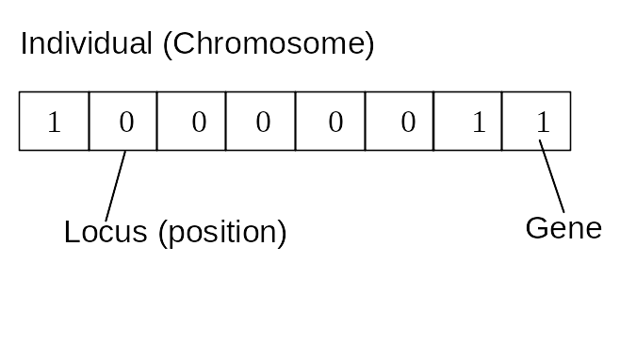
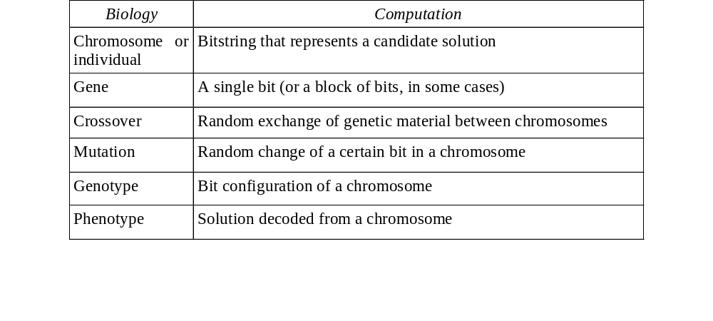
Vocabulary

Slide 81
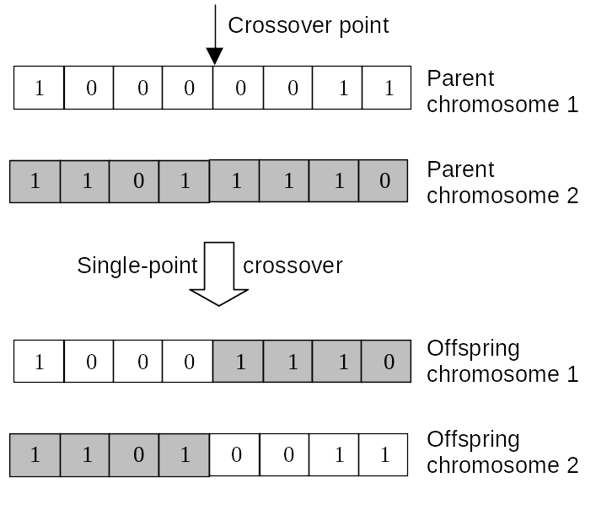
Crossover

Slide 82
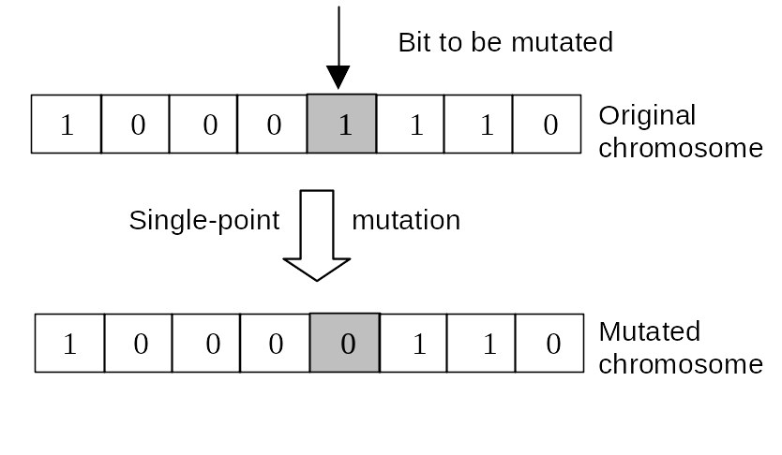
Mutation
Alter each gene independently with a prob p_{m}
(mutation rate)
1/pop_size < p_{m} < 1/ chromosome_length

Slide 83
Reproduction
Chromosomes are selected to crossover and produce offspring
Obey the law of Darwin:
Best survive and create offspring.
Roulette-wheel selection
Tournament Selection
Rank selection
Steady state selection

Slide 84
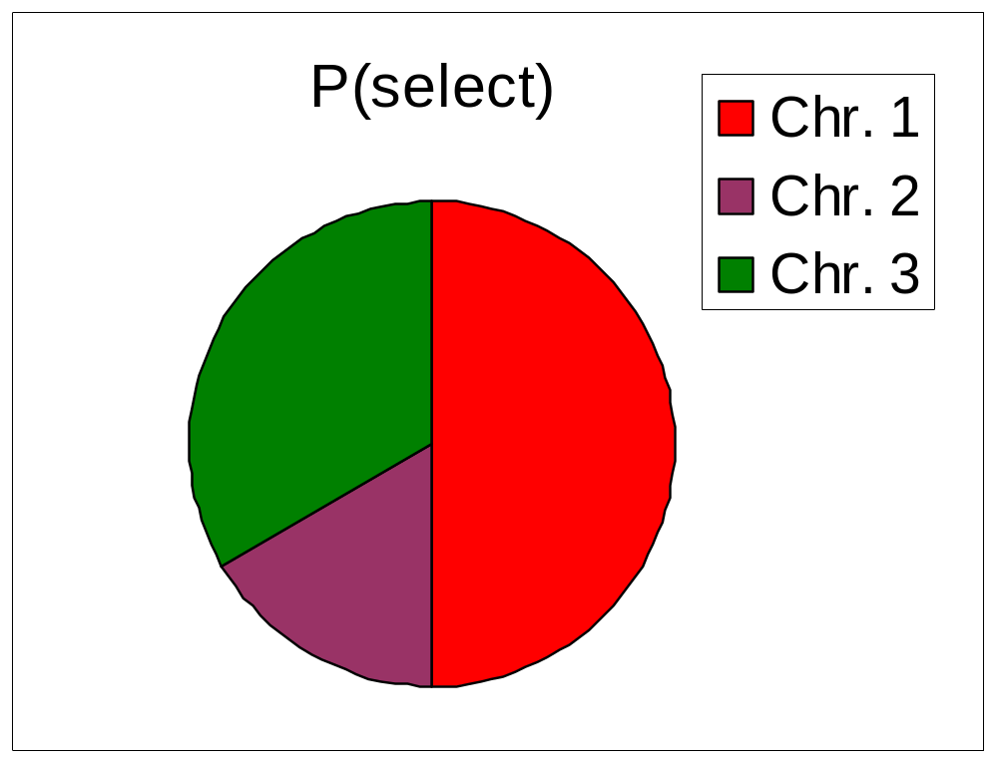
Roulette Wheel Selection
Main idea: better individuals get higher chance
– Chances proportional to fitness
– Assign to each individual a part of the roulette wheel
– Spin the wheel n times to select n individuals
 | Fitness
Chr. 1 | 3
Chr. 2 | 1
Chr. 3 | 2

Slide 85
Tournament Selection
Tournament competition among N individuals (N=2) are held at random.
The highest fitness value is the winner.
Tournament is repeated until the mating pool for generating new offspring is filled.

Slide 86
Rank Selection
Roulette-wheel has problem when the fitness value differ greatly
In rank selection the
  worst value has fitness 1,
  the next 2,......,
  best has fitness N.

Slide 87
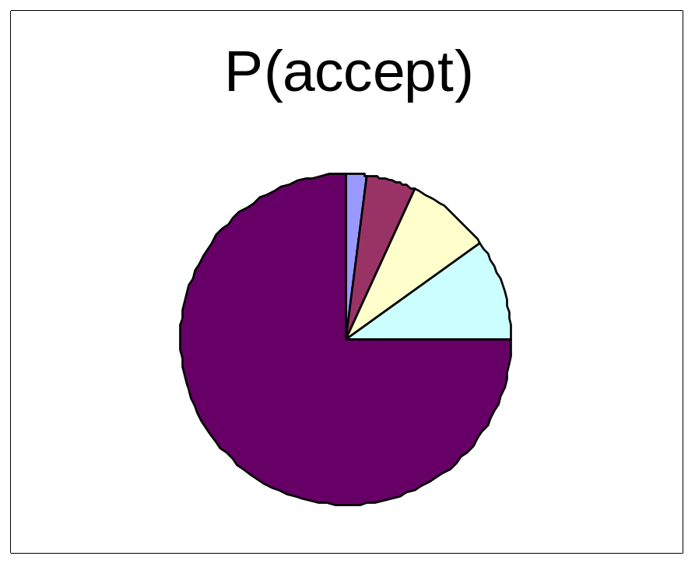
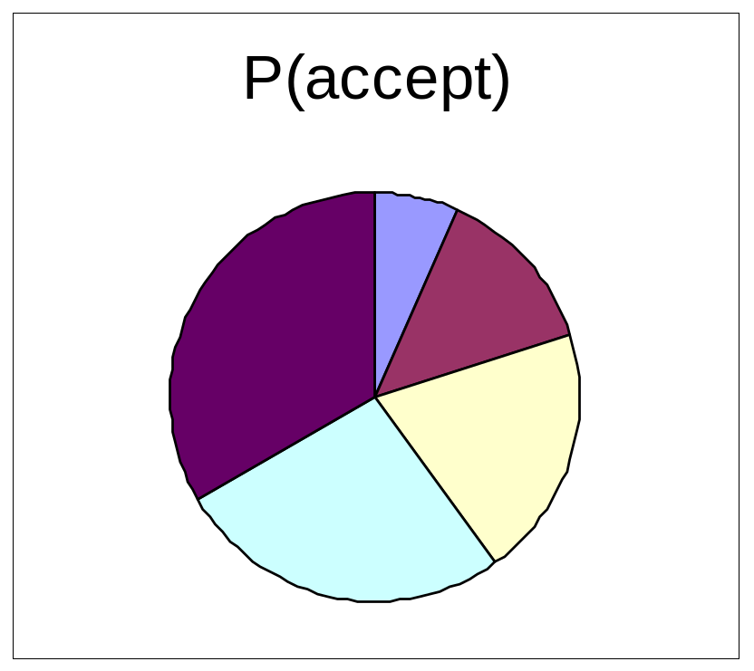
Rank Selection vs Roulette
2%
7%
5%
8%
13%
33%
10%
20%
75%
27%
Roulette Wheel
Rank

Slide 88
Crossover
Single –site crossover
Multi-point crossover
Uniform crossover

Slide 89
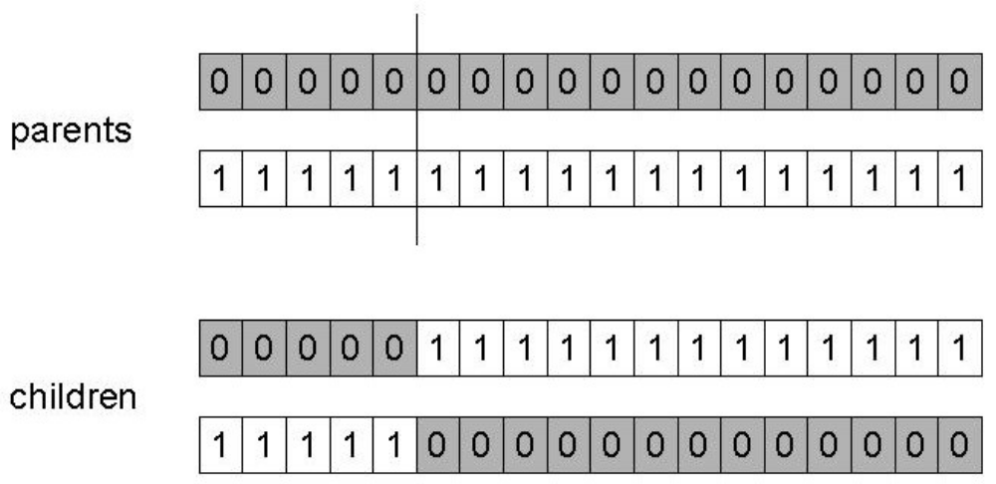
Single-site
Choose a random point on the two parents
Split parents at this crossover point
Create children by exchanging tails
P_{c} typically in range (0.6, 0.9)

Slide 90
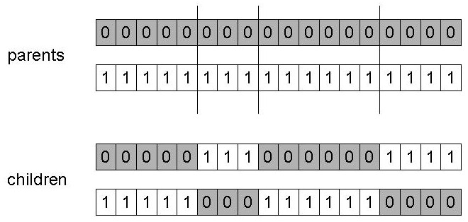
n-point crossover
Choose n random crossover points
Split along those points
Glue parts, alternating between parents
Generalisation of 1 point (still some positional bias)

Slide 91
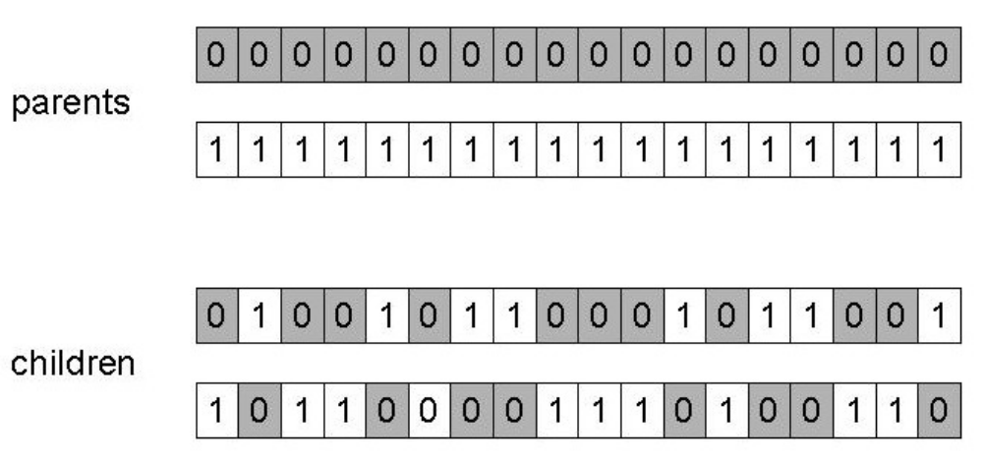
Uniform crossover
Assign 'heads' to one parent, 'tails' to the other
Flip a coin for each gene of the first child
Make an inverse copy for the second child
Inheritance is independent of position

Slide 92
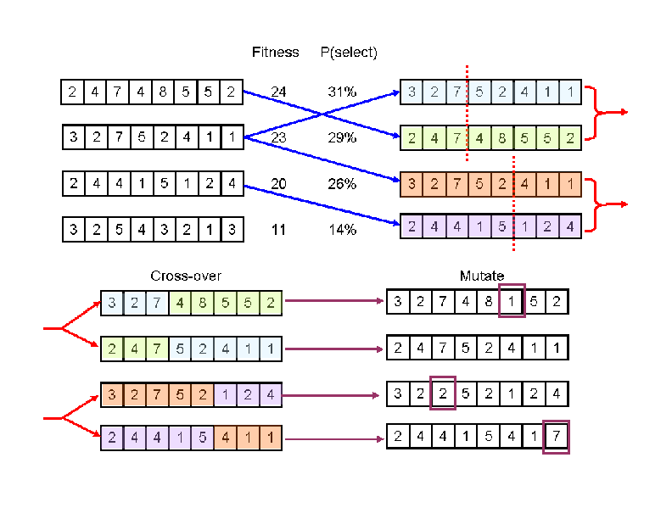
Genetic Algorithm

Slide 93
Memetic Algorithm
Memetic Algorithm =
Genetic Algorithm +
Local Search
E.g.:
  LS after mutation
  LS after crossover

Slide 94
Demo
http://www.rennard.org/alife/english/gavintrgb.html

Slide 95

Ant Colony Optimization
Another “Biological Analogue”
Observation: Ants are very simple creatures, but can achieve complex behaviours
Use pheromones to communicate

Slide 96
Ant Colony Optimization
Ant leaves a pheromone trail
Trails influence subsequent ants
Trails evaporate over time
E.g. in TSP
  Shorter Tours leave more pheromone
  Evaporation helps avoid premature intensification

Slide 97
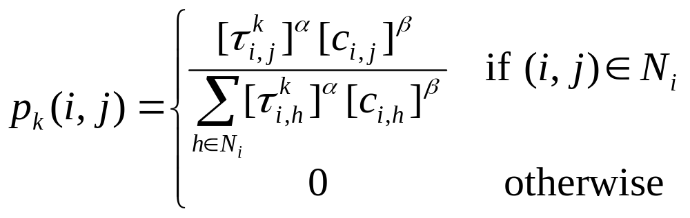
ACO for TSP
p_{k}(i,j) is prob. moving from i to j at iter k
α, β parameters

Slide 98
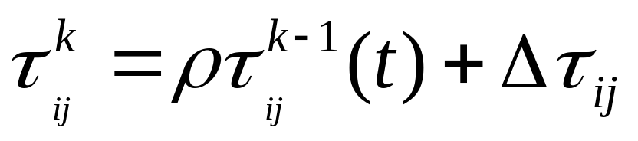
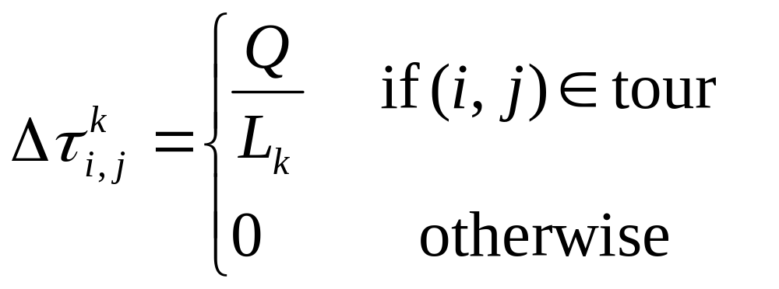
ACO for TSP
Pheromone trail evaporates at rate ρ
Phermone added proportional to tour quality

Slide 99
References
Emile Aarts and Jan Karel Lenstra (Eds), Local Search in Combinatorial Optimisation Princeton University Press, Princeton NJ, 2003
Holger H. Hoos and Thomas Stützle, Stochastic Local Search, Foundations and Applications, Elsevier, 2005

